Slide 1

PRESENT YOURSELF
CSE390 Technical Communication
Midterm Assignment
Subhi Bhuiyan
Id: 17201116

Slide 2
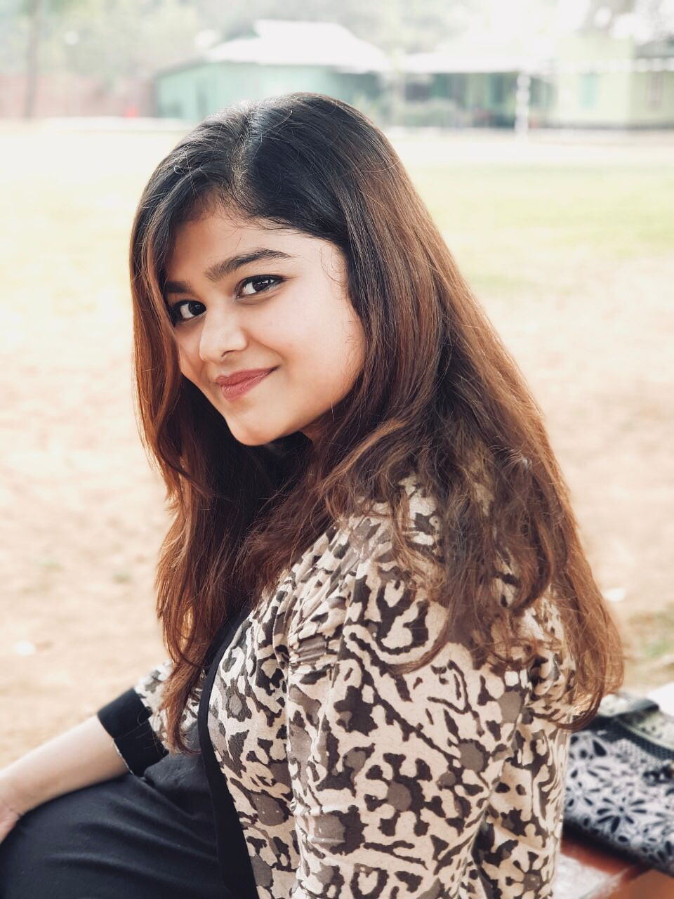
ABOUT MYSELF
My name is Subhi Bhuiyan.
The meaning of Subhi is “Early Morning”
Born on 9th November, 1997
My blood group is AB+
Ambivert

Slide 3
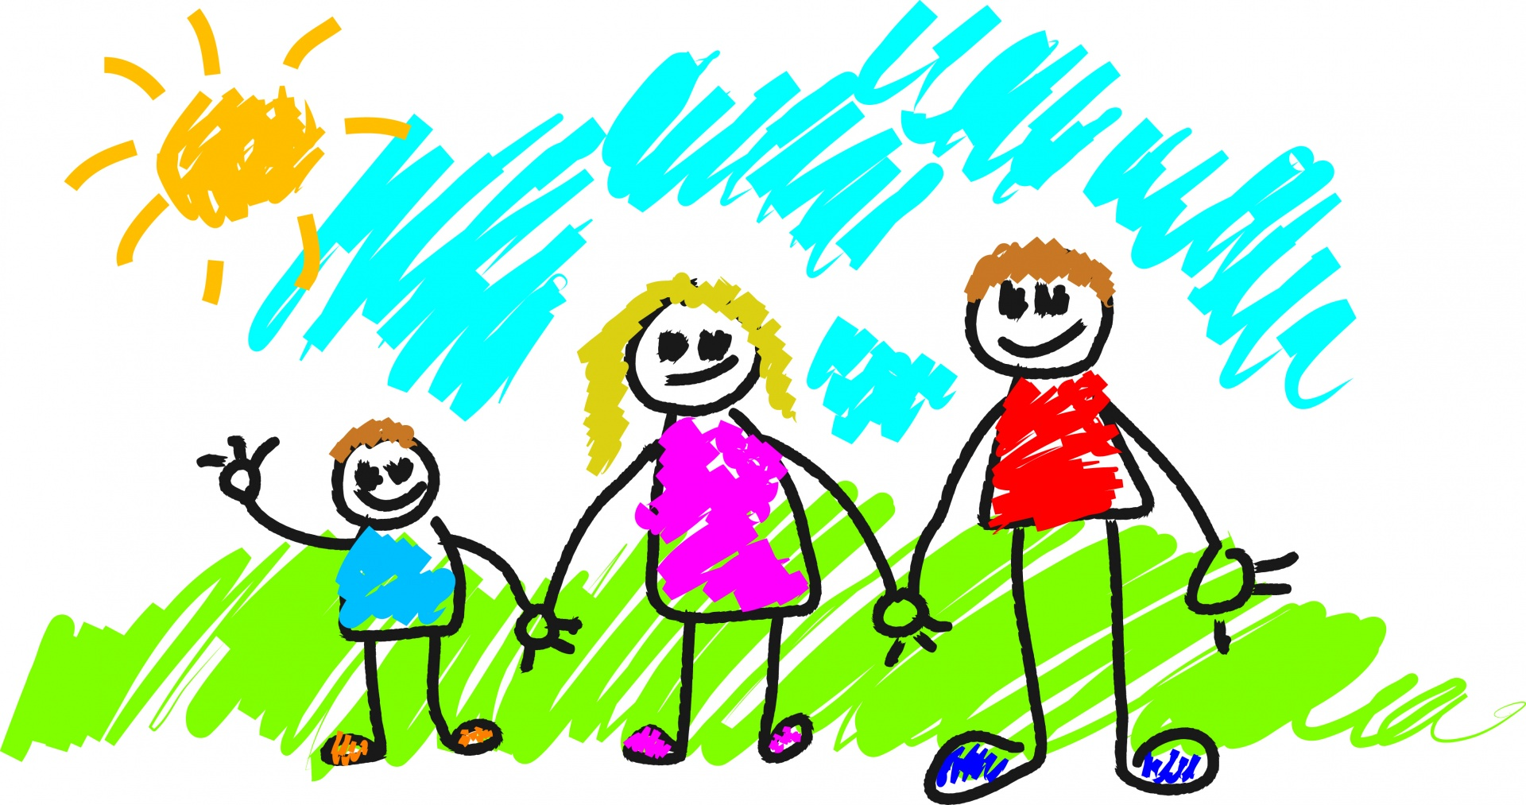




MY FAMILY
I live in a joint family
Mother was a Homemaker
Father is a Civil Engineer
Two brothers
I am the middle child

Slide 4
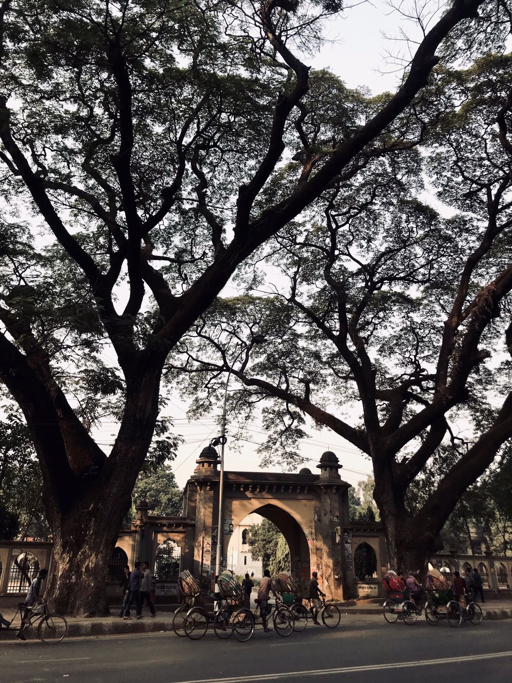




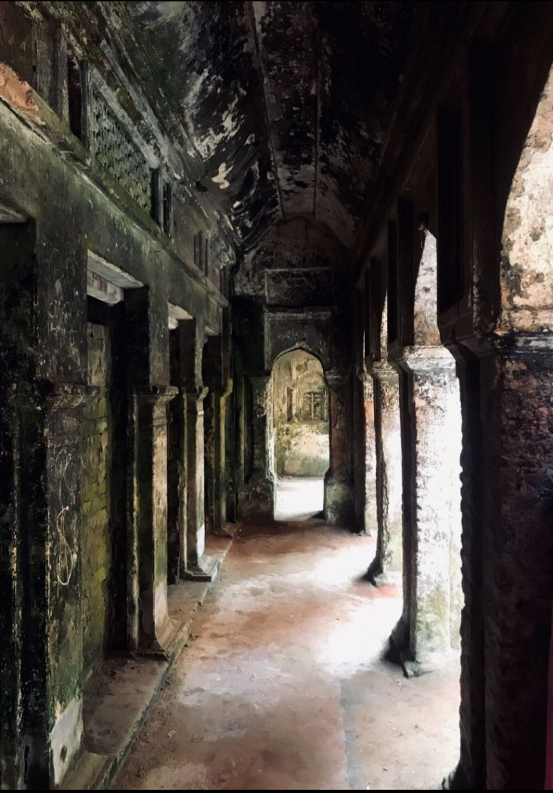
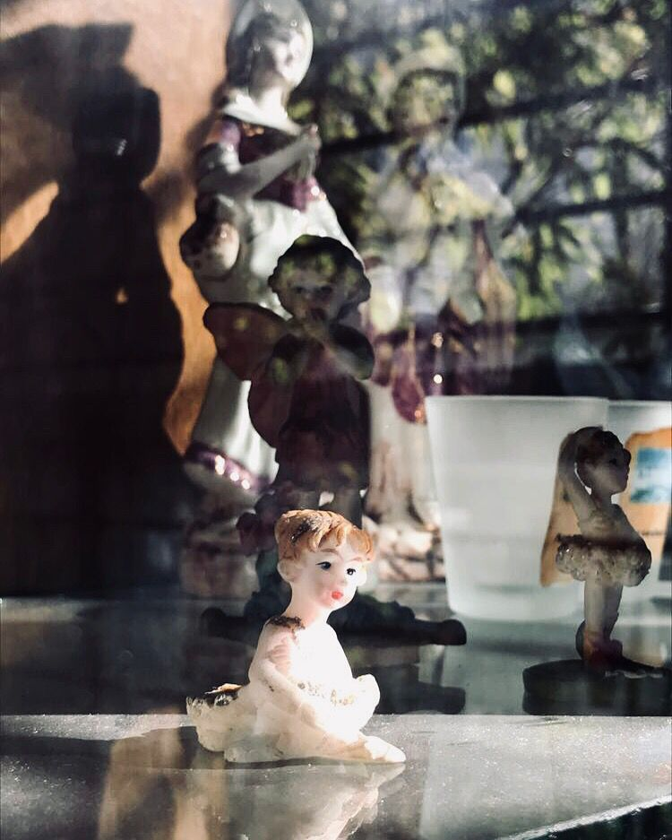

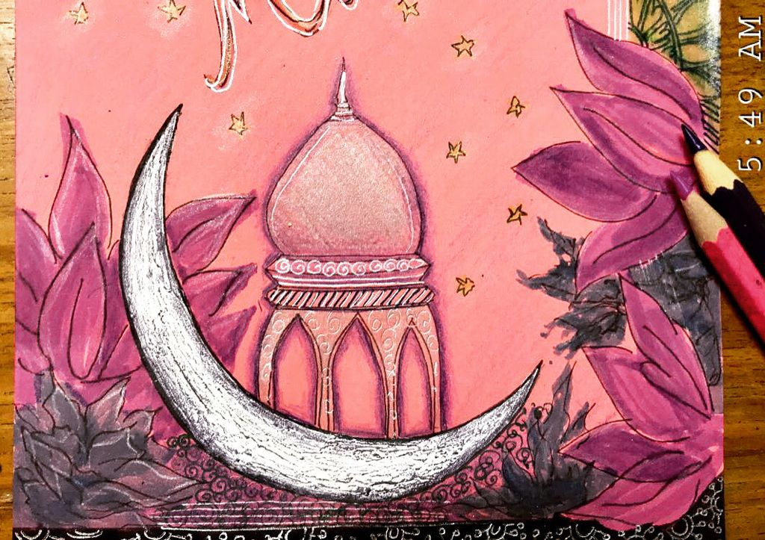
HOBBIES
Photography and Music
Play the Guitar
Watercolor Painting
Reading & Writing
Orange belt in Karate

Slide 5
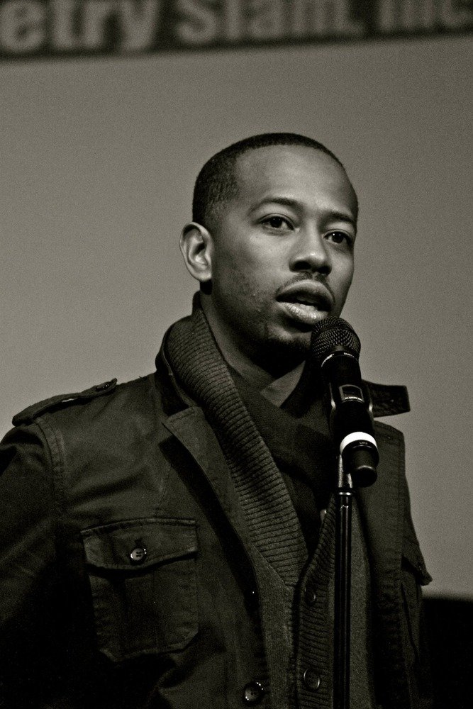
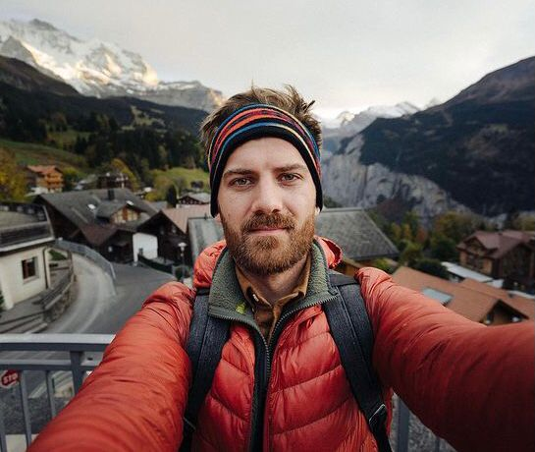
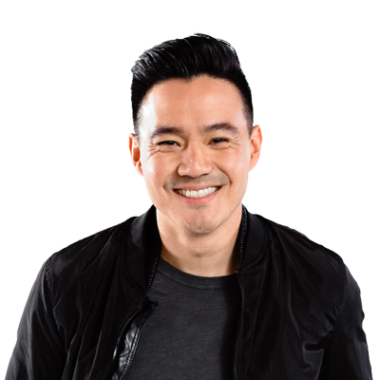

INSPIRATION
Rudy Francisco
Johnny Harris
Philip Wang
Documentary Filmmaking is my dream job
I love the aesthetic of visual storytelling
Binge watch comedy skits or slam poetry
Great Big Story ,Wong Fu Productions and Button Poetry

Slide 6

WHAT DO I DO?
Majoring in Computer Science from BRAC University
-------------------------
Teach Mathematics and Chemistry
-------------------------
Work in the tech industry
-------------------------Build opportunities for marginalized groups

Slide 7
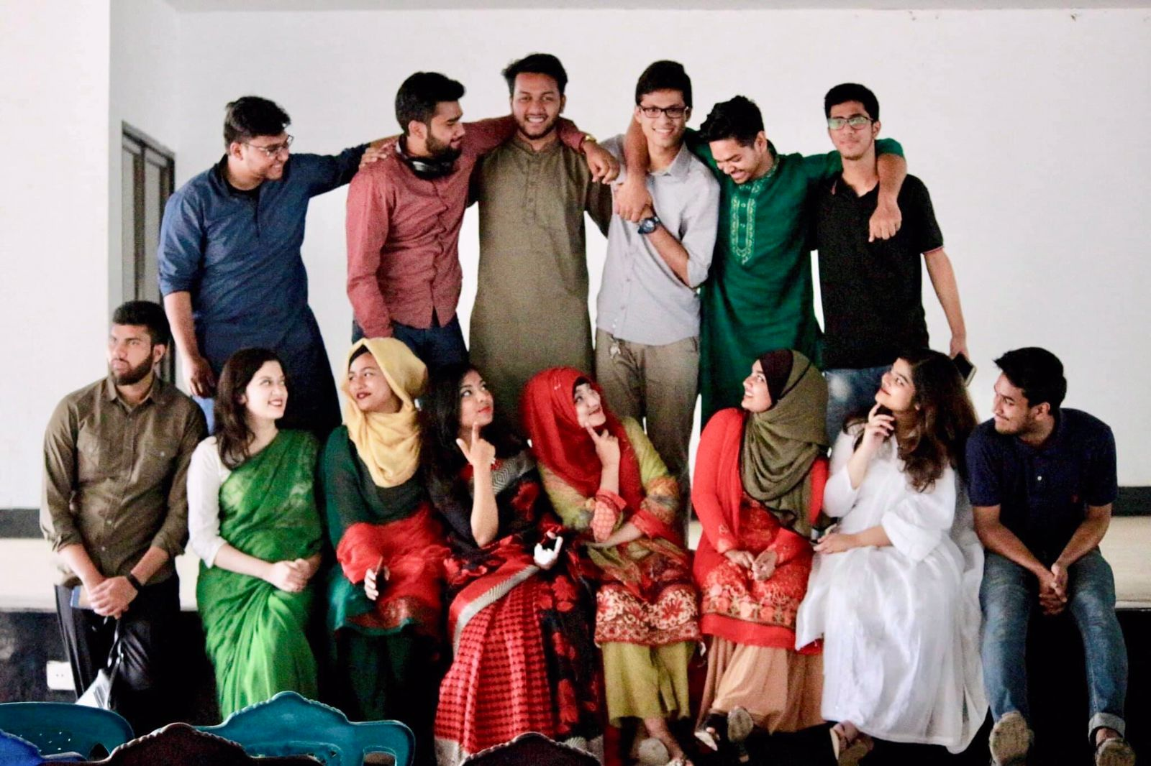
On Life..
We are all given a scene. A combination of people, places and things
that we don’t have any control over.
But it’s up to us to frame it in a way to get the best shot.
Question is: What’s the best shot?
We’ll know when we see it.
So just keep looking.
Keep going.

Slide 8

Thank you!

